Slide 1
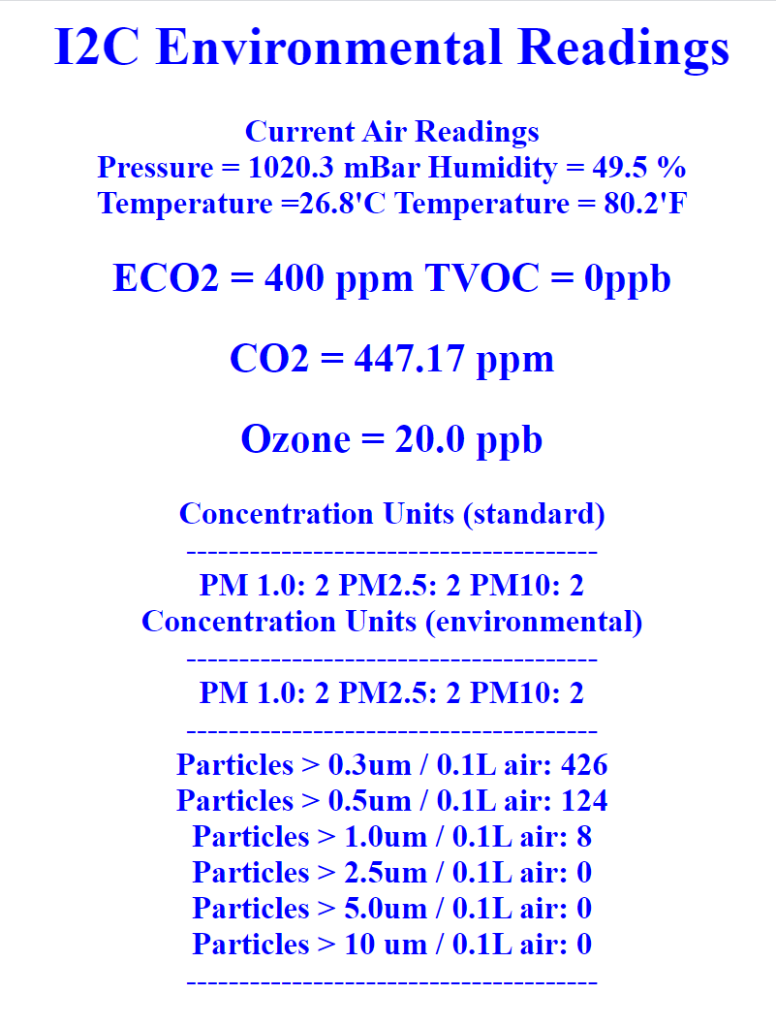

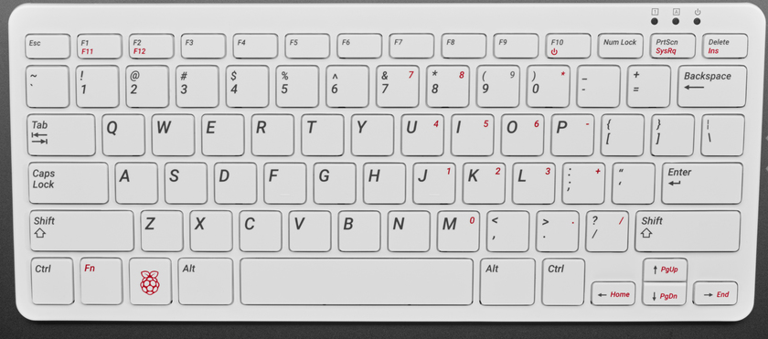
Intermediate Raspberry Pi and I2C Sensors
By Chuck Duey
Sept 29th, 2021
TM Raspberry Pi Foundation www.raspberrypi.org

Slide 2
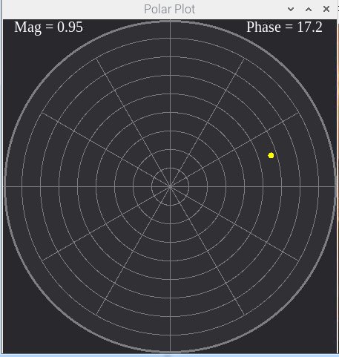
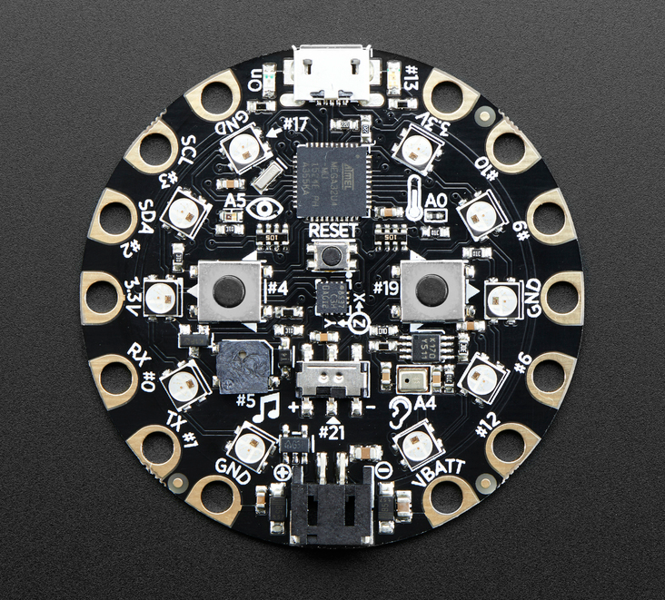
Outline:
TM Raspberry Pi Foundation www.raspberrypi.org
Your project and programming
Different embedded systems
Raspberry Pi Versions.
Installation and setup of a Raspberry Pi.
Useful tools for use with Raspberry Pi
Raspberry Pi Packages
Raspberry Pi Programming
IP Addresses and Sockets
Raspberry Pi IO
Add on Hats, Bonnets and USB devices with Demos
The I2C bus Air Sensing Station.

Slide 3
Think About the Scope of Your Project
Do not procrastinate!
Many projects try to reach too far. Start simple and improve over the semester.
Think a little ahead on what might be wanted. For example, it is easier to get a board with Wi-Fi than add it later.
Does your project need analog I/O? Some systems have it built in, other need addon boards.
Hardware is only part of the picture; most projects need more time to write and debug the software.
When possible, have two of any critical hardware piece. At the last minute, hardware breaks or gets damage.

Slide 4
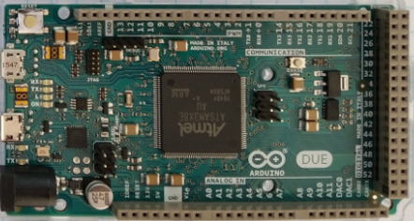
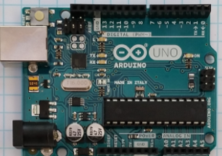
Arduino
Advantages
Many different I/O’s built-in including ADC.
Very nice IDE. (Integrated Development Environment)
Huge opensource community for both hardware and software.
Many premade shields and hardware addons.
Disadvantages
ADC lower resolution and slow. Difficult to do audio speeds.
Need to get a Wi-Fi/BT version in advance, or add on for IOT
Not easy to get a high-resolution dynamic display.

Slide 5
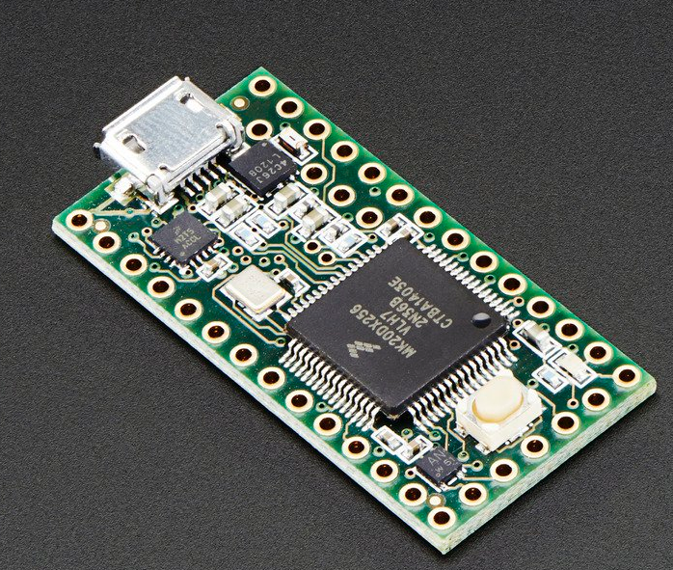
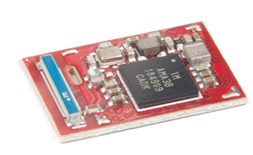
Teensy and Other Small Variants
Arduino like IDE and programming.
Many with Analog I/O.
Very small and low power.
More difficult to prototype with.
ADC lower resolution and slow. Difficult to do audio speeds.
Need to get a Wi-Fi/BT version in advance, or add on for IOT
Teensy 3.2
Adafruit
Circuit Playground
SparkFun Artemis

Slide 6
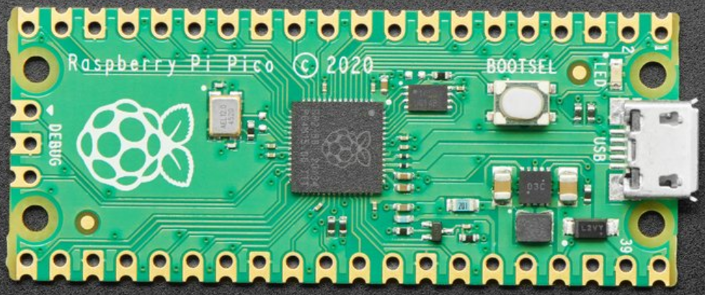
RP2040 – Raspberry Pi Pico
Dual ARM Cortex-M0+ @ 133MHz
264KB RAM 2MB Flash
CircuitPython, MicroPython, C/C++
30 GPIO pins
4 analog inputs
2 UARTs
2 SPI controllers
2 I2C controllers
16 PWM channels
Need to get additional screen for display.
ADC lower resolution and slow. Difficult to do audio speeds.
No Wi-Fi/BT need to add add on for IOT
Currently no Arduino IDE support.

Slide 7
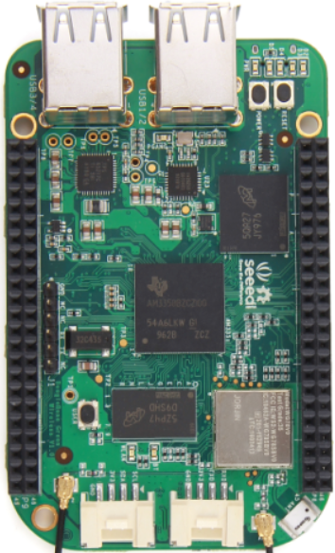
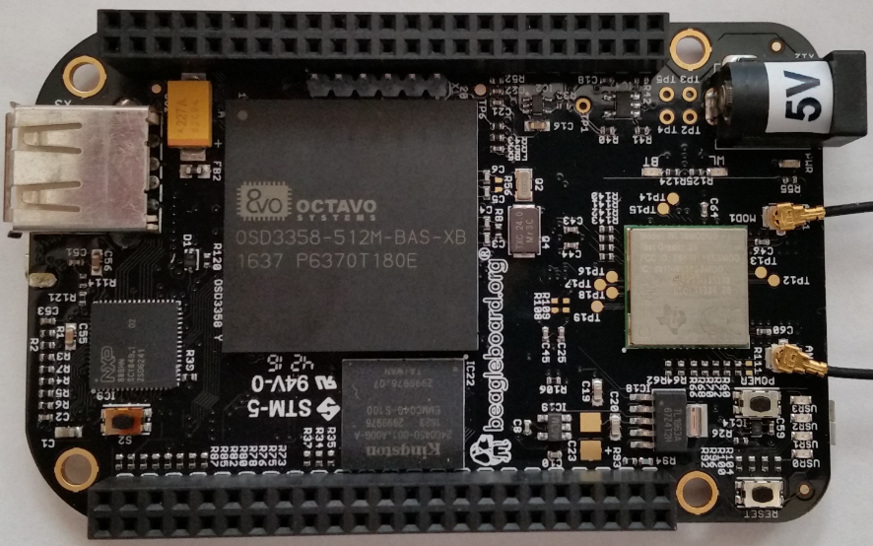
BeagleBone
Advantages
Linux operating system. Can program in many languages and interact with the internet.
Can make Webpages and run full LAMP stack.
Open-source software and hardware support.
Fast ARM core processor.
The Black Version has a micro-HDMI display.
Analog inputs!!!
Disadvantages
Display resolution not that good.
Single Core ARM Processors.
Operating system overhead.
Costs more than Raspberry Pi
Community support is not as wide as Raspberry Pi
Operating system and Overlays not stable.

Slide 8
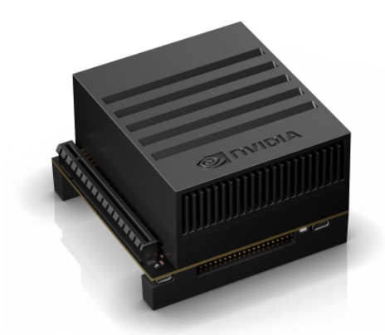
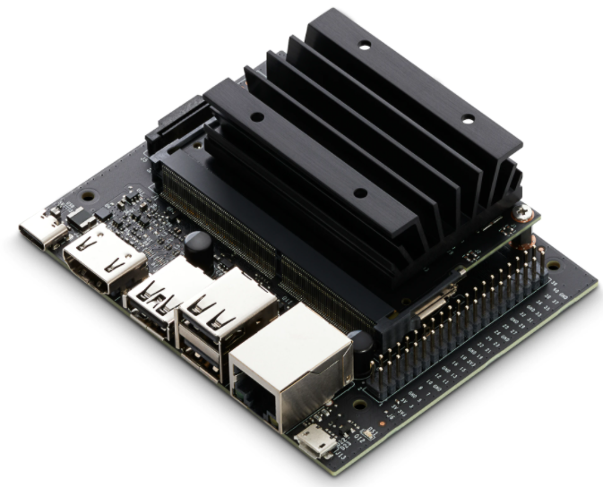
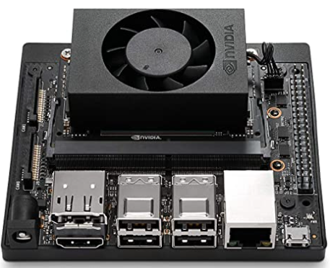
Nvidia Jetson Family
Advantages
Ubuntu Linux Operating System
Open-source software and hardware support.
Industrial use and quality
Fast ARM core processors and GPU.
Uses same 40 pin connector as Raspberry Pi.
Disadvantages
Cost for higher end units >$300.00
Need to add on hardware for Analog inputs.
Power hungry when compared to other micro controllers.
Operating system overhead.
40 pin connector rotated 180 degrees from Raspberry Pi.
AGX $599
Nano $59
NX $399

Slide 9

Time to talk about Raspberry Pie

Slide 10
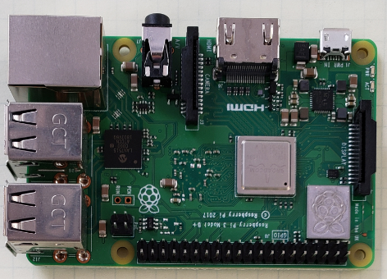
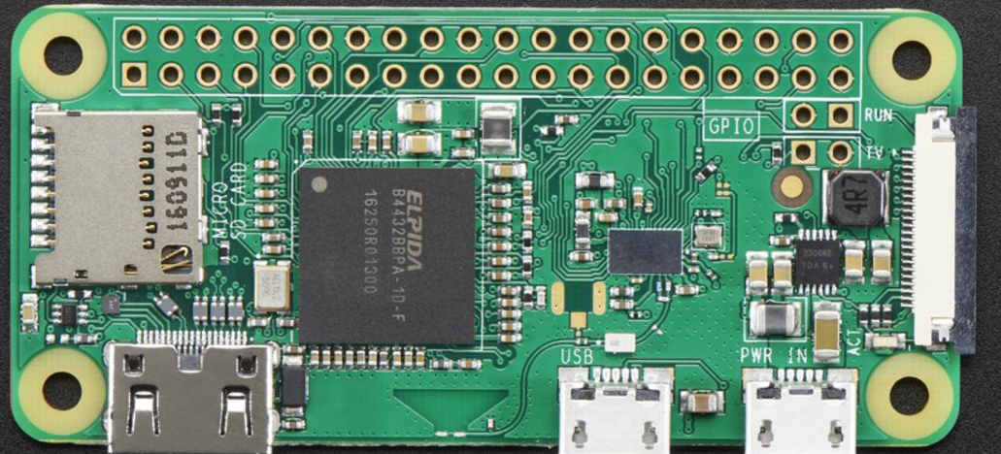
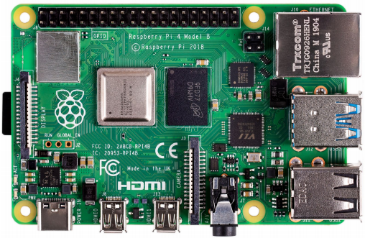
Raspberry Pi
Advantages
Linux operating system. Can program in many languages and interact with the internet.
Can make Dynamic interactive Webpages and run full LAMP stack.
Massive open-source software and hardware support.
Very fast ARM core processor.
Easy to implement GUIs for interactive programs.
Disadvantages
Need to add on hardware for Analog inputs.
Power hungry when compared to other micro controllers.
Operating system overhead.
Heat dissipation on newer versions

Slide 11
Difference between the Raspberry Pi Versions
Model | B | B+ | Pi 2 | Zero/W | Pi 3 A+ | Pi 3+ | Pi 4 | Pi 400
CPU | Arm 6 700MHz | Arm 6 700MHz | 4xArm 7 900MHz | Arm 6 1000MHz | 4xArm 53 1400MHz | 4xArm 53 1400MHz | 4xArm 72 1500MHz | 4xArm 72 1800MHz
RAM | 512MB | 512MB | 1GB | 512MB | 512MB | 1GB | 1GB/2GB/4GB/8GB | 4GB
USB | 2 | 4 | 4 | 1 | 1 | 4 | 2-2.0 2-3.0 | 1-2.0 2-3.0
Network | 10/100 | 10/100 | 10/100 | None/Wi-Fi | Wi-Fi | 10/300 Wi-Fi abg | 10/100/1G Wi-Fi abg | 10/100/1G Wi-Fi abg
Video | HDMI/NTSC/PAL | HDMI/NTSC/PAL | HDMI/NTSC/PAL | HDMI | HDMI/NTSC/PAL | HDMI/NTSC/PAL | 2xHDMI NTSC/PAL | 2xHDMI
Hardware IO | 17 | 25 | 25 | 25 | 25 | 25 | 25 | 25
+5V Supply | 1A | 1A | 1.5A | 500mA | 1A | 2.5A | 3.0A | 3.0A
Bluetooth | No | No | No | Yes/W | Yes | Yes | Yes | Yes
SD Card | Mini | Micro | Micro | Micro | Micro | Micro | Micro | Micro
Cost | $30 | $25 | $35 | $5/$10 | $25 | $35 | $35/$45/$55 | $70

Slide 12
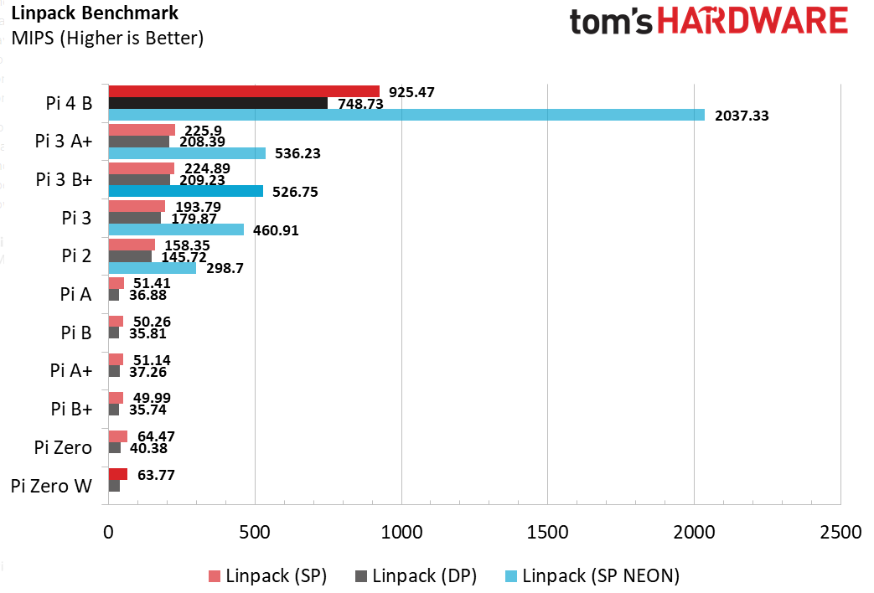
CPU Speed Benchmarks

Slide 13
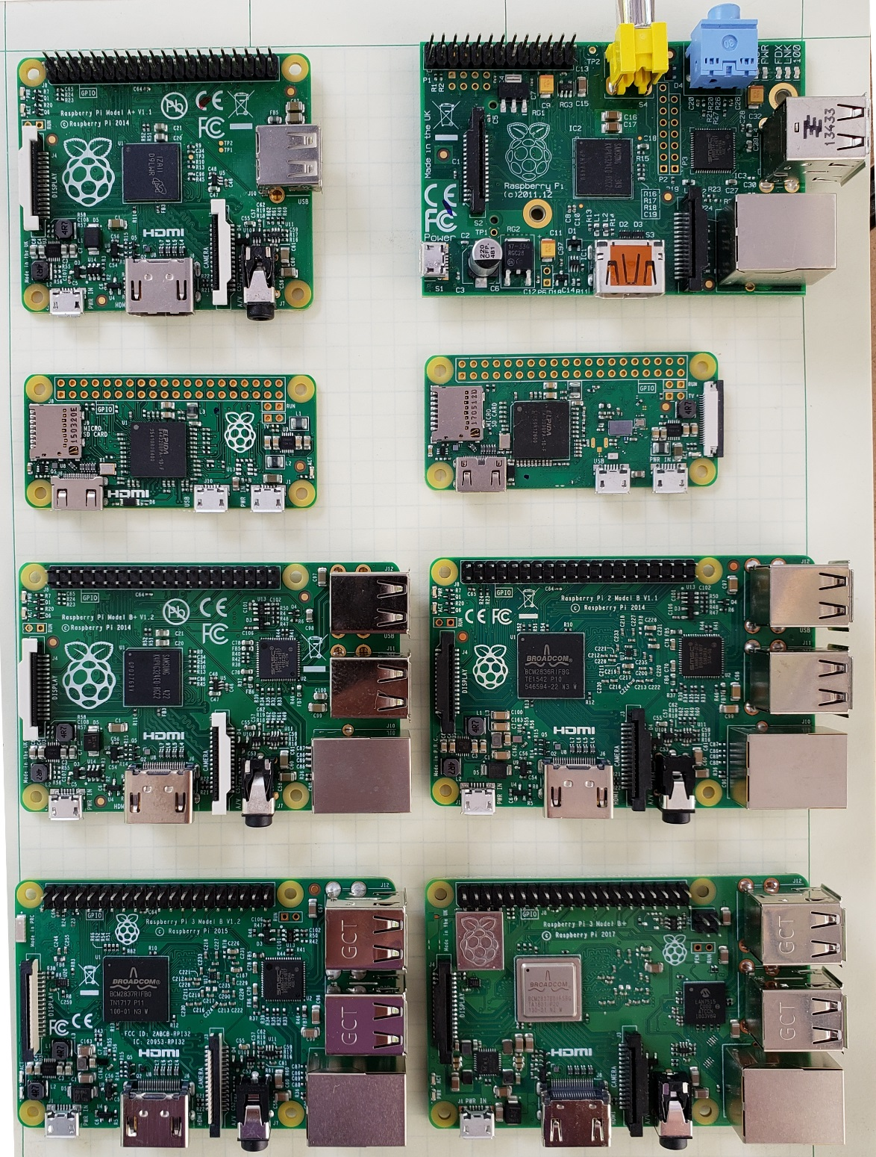
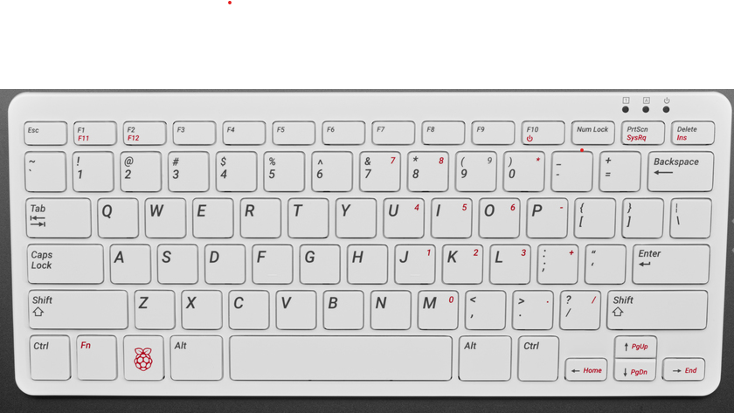
Which Pi Do you have?
A+
B
Zero
Zero W
Pi 400
B+
Pi2
Pi4
Pi3
Pi3+

Slide 14

Some Raspberry Pi Resources
TM Raspberry Pi Foundation www.raspberrypi.org
Good Links and web sites:
www.raspberrypi.org —The Foundation’s Website
www.raspberrypi.org/downloads — Various Raspberry Pi Operating Systems
https://elinux.org/RaspberryPiBoard - Raspberry Pi Wiki Pages
www.tomshardware.com – Good Linux and Pi tutorials and reviews.
www.adafruit.com — Adafruit very good site for parts and tutorials
learn.adafruit.com/category/raspberry-pi —Many projects and how to’s at Adafruit
www.sparkfun.com —Raspberry Pi parts and many other Hobby parts. (Colorado Co.)
www.newark.com —Low priced Raspberry Pi Parts
www.microcenter.com —Online and In Store Raspberry Pi
www.instructables.com/howto/Raspberry+Pi/ Lots of good Pi Tutorials
https://github.com/Chuckduey/CSU_Pi_Class.git GitHub page with the code from this class.
My email cduey@msn.com

Slide 15
Important Raspberry Pi Tips
Do Not add or remove hardware while running. Including USB devices. Plugging in heavy load on the USB at the last minute can kill the SD card.
Power down the Raspberry Pi using a software command before removing power. SD corruption is very common on uncontrolled power downs.
SD cards are fragile and wear out. Keep a backup copy of your code. It is best to store it on a network drive.
SD cards come in various speeds and sizes. Class 10 is the fastest. For the Older than version 3, Raspberry Pi SDHC 32GB is the maximum sized. For the Newer Pi’s 256GB SDXC can be used.
The Raspberry Pi I/O ports are 3.3V. A 5V signal will render the port, and possibly the whole Pi useless.
The Micro SD cards are very easy to pop out accidentally. If it does while it is running, resist the temptation to plug it right back in. Power down first!!!

Slide 16






Raspberry Pi Raspbian (Debian) Versions
Initial Release Date | Current Release Name | Debian Version | Linux Kernel | GCC | apt | X Server | Raspberry Pi 1/1+ | Raspberry Pi 2 | Raspberry Pi 3 | Raspberry Pi 3+ | Raspberry Pi 4 | Raspberry Pi 400
2013-09-27 | 2015-05-05 | 7 (Wheezy) | 3.18 | 4.7.2 | 0.9.7 | 7.7
2015-09-28 | 2017-07-05 | 8 (Jessie) | 4.9 | 4.9 | 1.0.9.8.1 | 7.7
2017-09-08 | 2019-04-08 | 9 (Stretch) | 4.14 | 6.3 | 1.4.9 | 7.7
2019-06-24 | 2021-05-07 | 10 (Buster) | 5.10.17 | 8.3 | 1.8.2.3 | 7.7
Bullseye
Buster
©

Slide 17
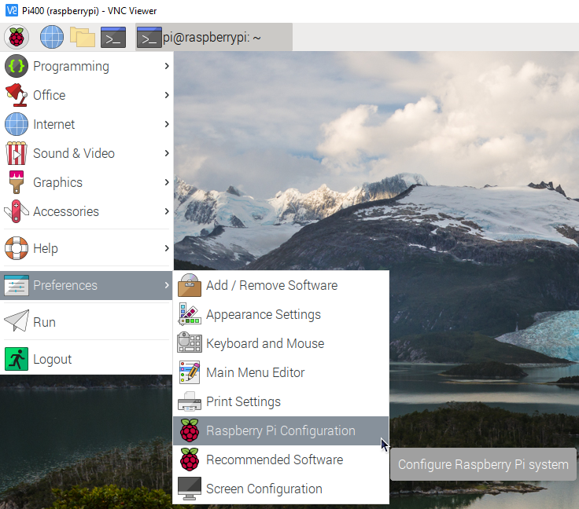
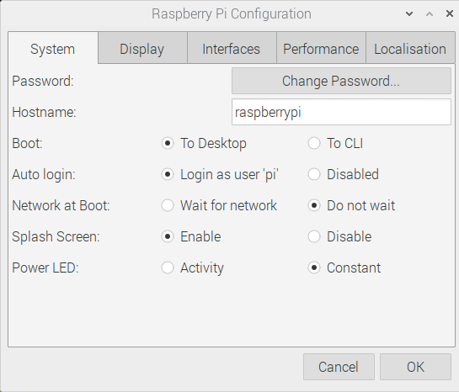
After Reboot

Slide 18
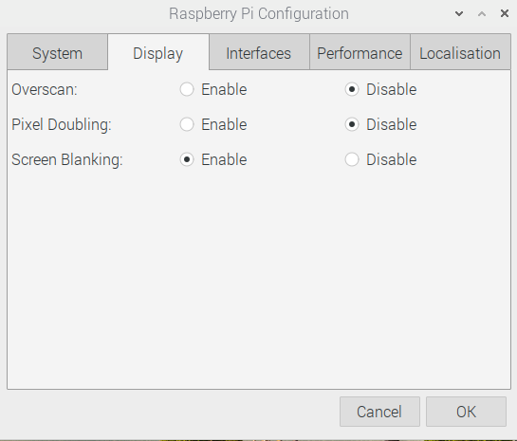
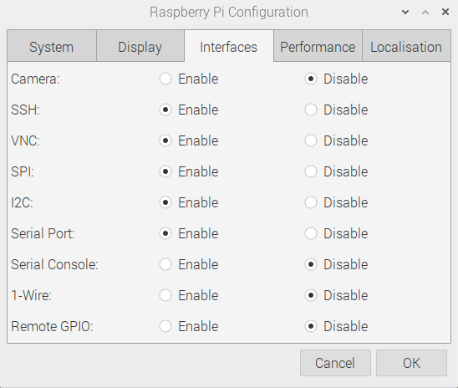
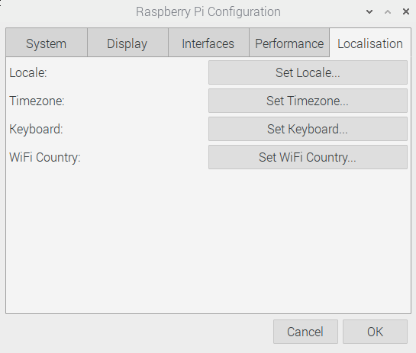
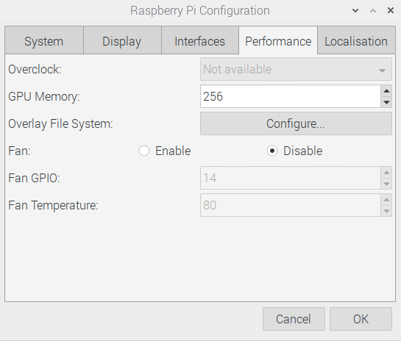
More Configuration
Camera if you have one
SSH for PuTTY and to transfer files
VNC for remote desktop
SPI for Fast Serial HW
I2C For slower serial HW
Serial Port for HW serial
Serial Console
1-Wire Single wire HW
Remote GPIO
If the keyboard or Time Zone is not set correctly
For systems with more the 2GB RAM – Increase GPU Memory

Slide 19
Useful Tools
Linux or MAC computer with USB and network.
With a Linux computer, it makes it easy to copy, change and back up Raspberry Pi SD cards using the “dd” command.
Also, the ssh, and ssh –X makes it easy to remote in to work.
Win32 Disk Imager - A perfect tool copying and backing up Raspberry Pi SD cards. Do not do a direct SD to SD copy.
PuTTY - creates a terminal window that can be used to “ssh” to any Linux computer on you network from a windows machine.
VNC/ RealVNC – VNC can display a desktop to another computer Linux or Windows. Very nice for remote work from different platforms.
USB power 3.0A or more - While most computers are limited to 500mA of current on the USB port, it is easy to have more that that draw from a Raspberry Pi with accessories.

Slide 20
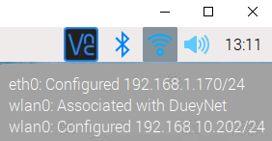
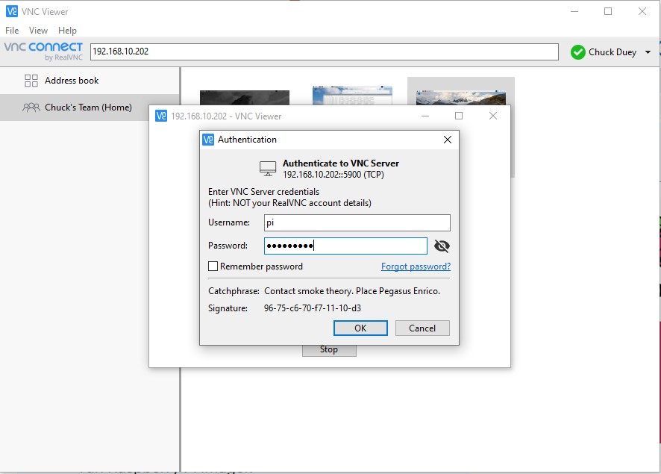
VNC – Remote access desktop
https://www.realvnc.com/en/connect/download/viewer/ - Download a viewer
Hover over network symbol in upper right to find address

Slide 21
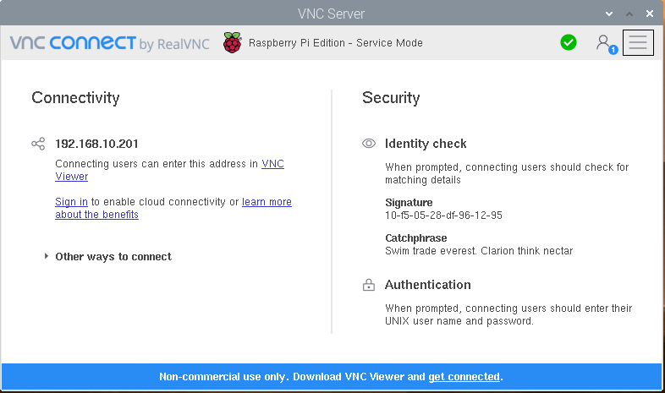
VNC to Your Pi from Anywhere
For Remote access set up an account. https://www.realvnc.com/en/raspberrypi/
Sign in once an account is created

Slide 22
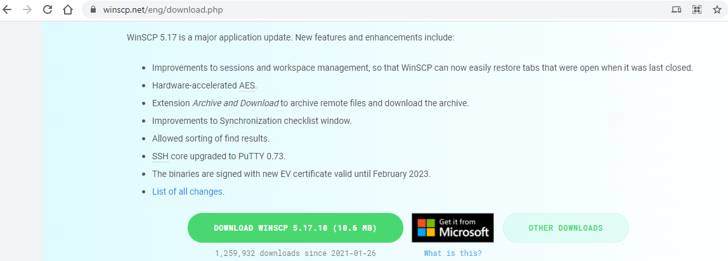
WinSCP
https://winscp.net/eng/download.php

Slide 23
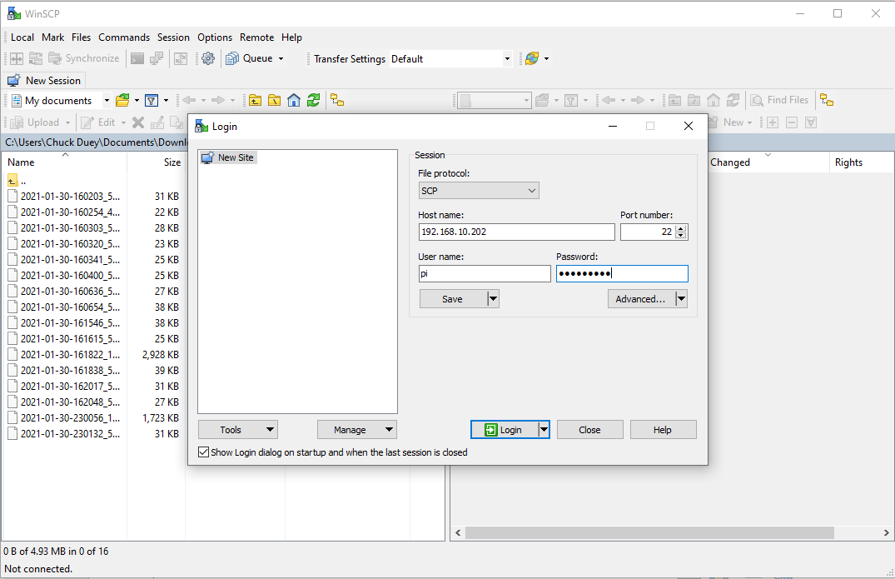
Using WinSCP
Set to SCP
IP Address of Pi

Slide 24
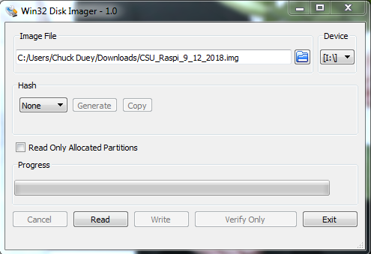
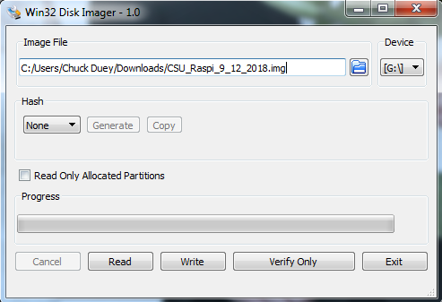
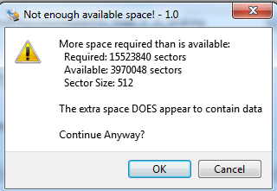
Quick Word on SD Cards They are not all the same.
Backup your files!!!! SD Cards will get corrupted.
When you copy an image, actual SD card size can vary by more than a GB. To burn to a new card the image size or bigger is needed! Both Windows and Linux copies will have this problem
If Linux dd is used, make sure to copy the root image. /dev/sdX not /dev/sdX0,1..

Slide 25
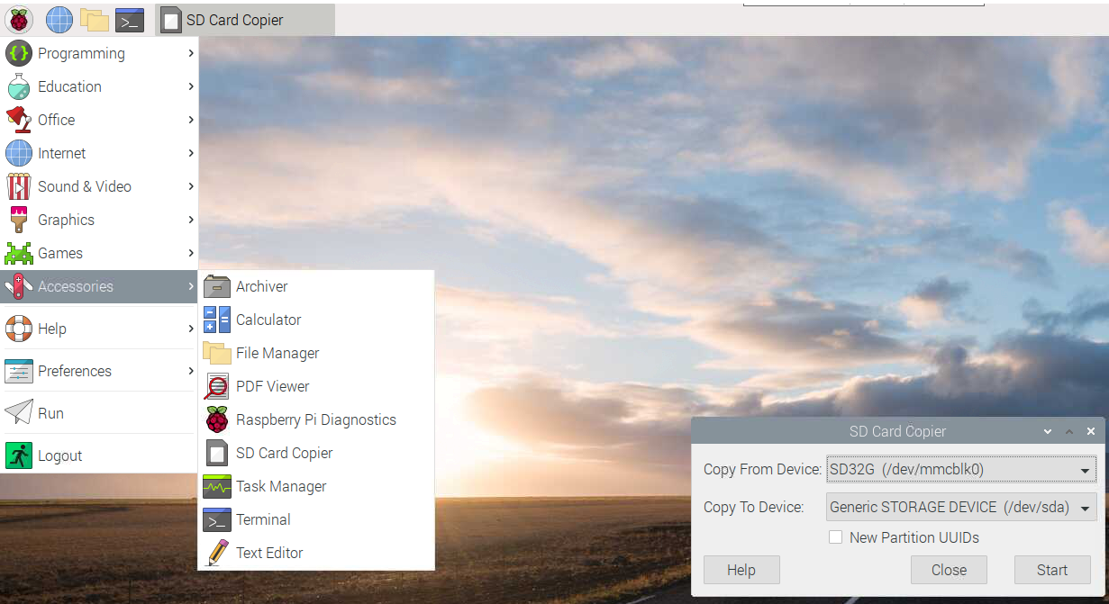
New Backup Tool SD Card Copier
Make a backup of your system. Copy From /dev/mmcblk0 never to!
While the copy is running close all other applications and do not make any changes to the file system.

Slide 26
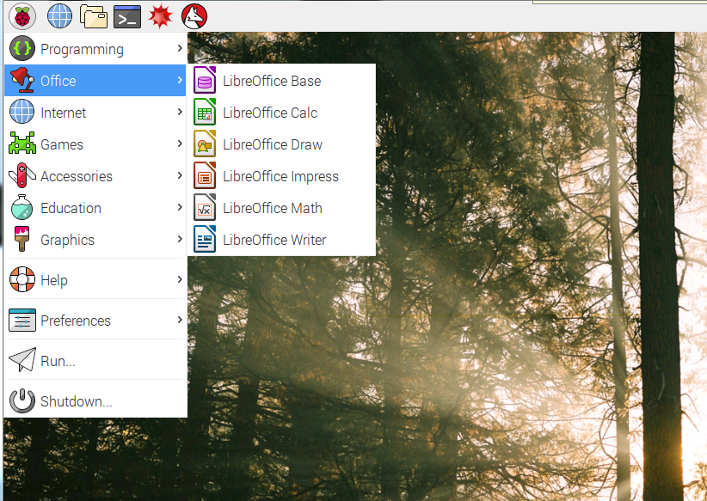
Raspberry Pi Raspian Buster

Slide 27
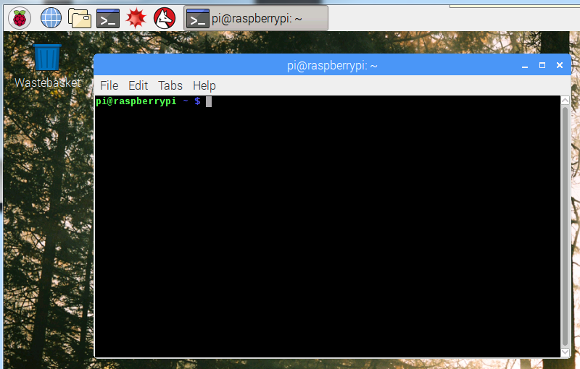
Terminal Window
Click here once

Slide 28
Terminal window commands
https://www.tomshardware.com/reviews/raspberry-pi-command-line-commands,6159.html
ls = list files in directory ls –l = List long ls –a = List all
cd (dir name) = change directory
df –h = Show file systems sizes and usage
nano (file) = Simple intuitive text editor
vi (file) = Simple powerful non-intuitive text editor.
cat (file) = output the contents of a file
less (file) = output a file one page at a time
apt install (package) = get a package to install
apt update = update packages
apt-cache show (key word) = show available packages
sudo = next command execute as root
ifconfig = show the ip interface connections

Slide 29
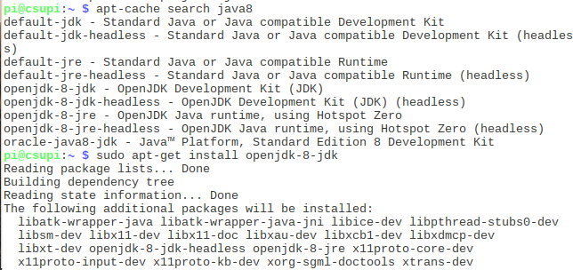
Ways to get applications and software packages
apt-cache search [package]
sudo apt install [package] octave, mysql, git, python-pip…
pip3 install ‘Some Application’
git clone git://[package site] git.osmocom.org/rtl-sdr-git
Download “tgz” file. tar –xzf package.tgz

Slide 30
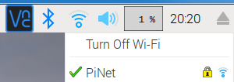
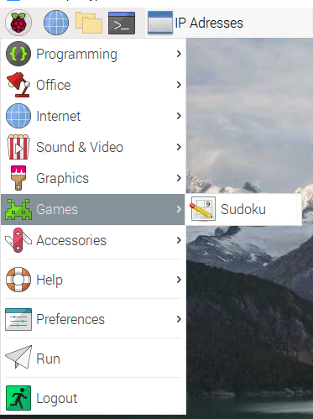
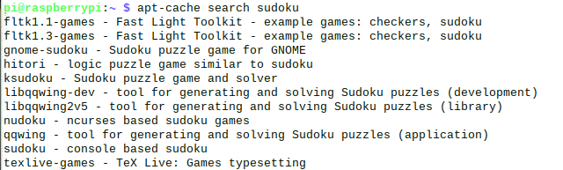
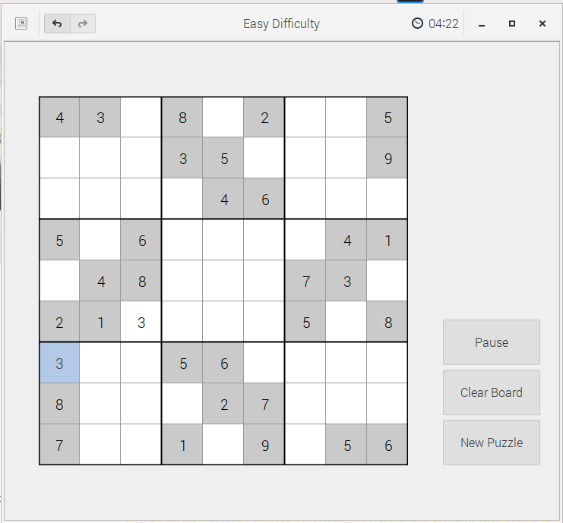
*Connect to internet and download package
Verify Connection to Wireless
Open a web page to www.google.com
Open a terminal and “apt-cache search sudoku”
sudo apt install gnome-sudoku
<- install Sudoko Puzzle Game>

Slide 31
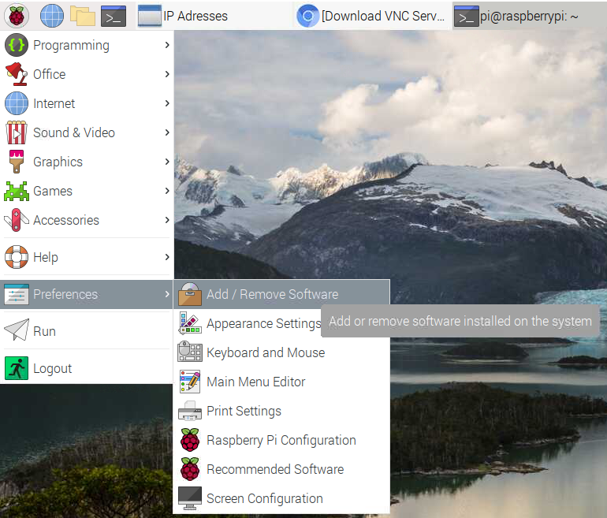
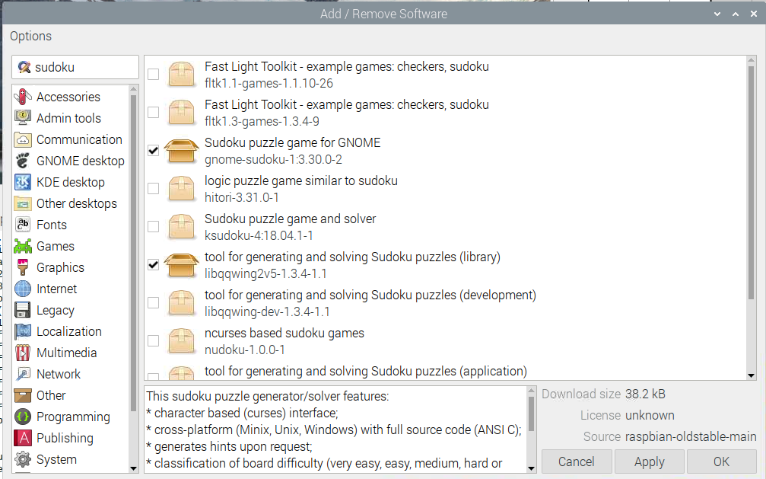
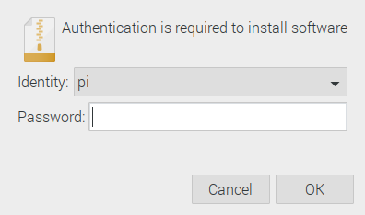
Alterative GUI method Preferences -> Add/Remove Software

Slide 32
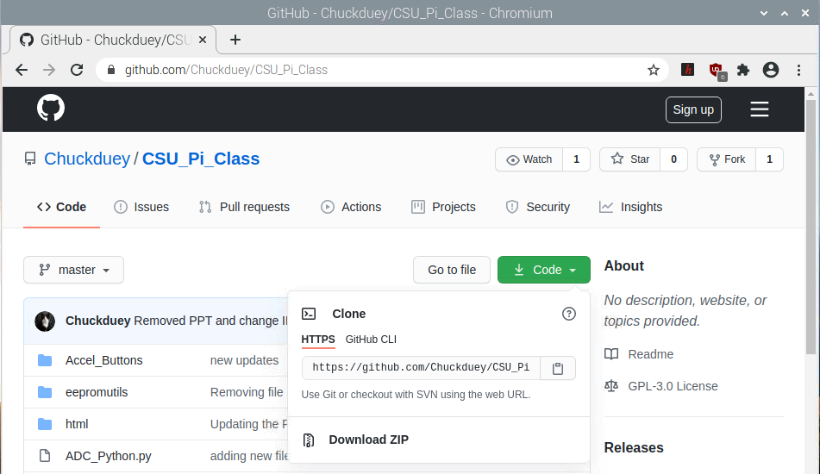
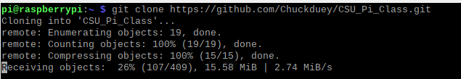
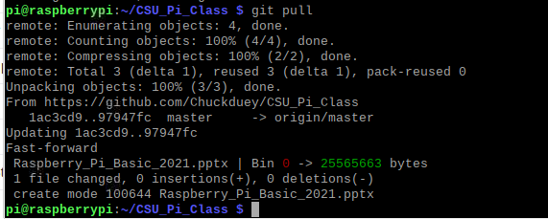
*GitHub Collaboration Tools
https://github.com/Chuckduey/CSU_Pi_Class
Left Mouse Click
git clone <Center Click>
git pull
This will get the latest release of the files.

Slide 33
GitHub – Great Collaboration Tool
For opensource projects it is Free.
Size limit is 500MB, and no file bigger than 100MB.
You can start a repository and control who can change it.
Changes can be made and tracked.
Branches of code and Tags can be generated.
Private Repos and Closed Repos can be made but require a monthly fee.
It is a great way to have an opensource project with collaboration.
A good basic class on GitHub:
https://www.coursera.org/learn/introduction-git-github

Slide 34
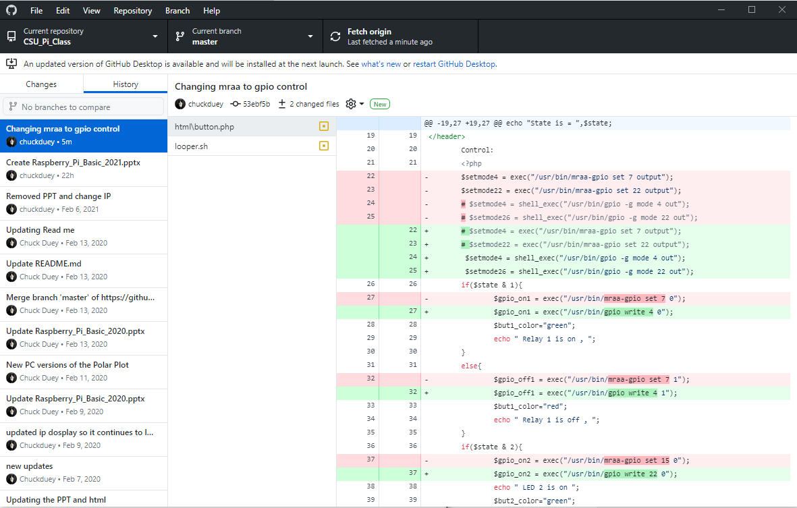
Example of GitHub Desktop

Slide 35
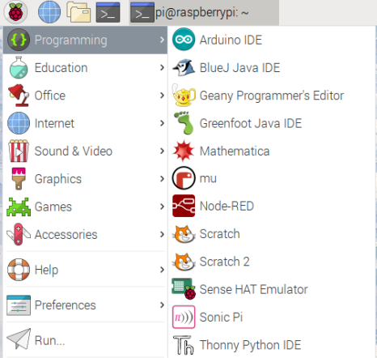
*Geany – A Good Generic Programming IDE

Slide 36

*Hello World! Geany
Change the code, save and run it.

Slide 37

*Hello World! Geany
Compile the code
Build
Then Run it

Slide 38

Communication via TCP Sockets
Computers on a network have an IP address consisting of 4 numbers 0 to 255, such as 192.168.5.223. With in the computer there are different services that correspond to ports numbered 0 to 65535. One such service on a computer is HTTP which corresponds to port 80. A webpage that a computer is serving would be on 192.168.5.223:80
Typically ports 0 to 1023 are system ports requiring elevated permissions to run. If a user wants to use a port 1024-65535 they can, but it may be blocked by a network firewall
If we use port 4321 we can communicate among the computers on the same subnet, but possibly not beyond that.
Good Reference: https://en.wikipedia.org/wiki/Network_socket

Slide 39

Communicating Via Sockets
In Geany open up socket_server.py, socket_client.py and socket_cl_addr.py
In start up the Socket Server “python socket_server.py”
Then start up “ python socket_client.py” and send a message.
Communication with “local host” 127.0.0.1

Slide 40


Now for some fun over the LAN
Find your IP address by running ip_display Trade addresses with neighbors
Then use “python socket_cl_addr.py” to send data to your neighbor.

Slide 41

When Ever Opening a Port Make it Resilient
nmap (Zenmap GUI)
Standard network tool.
Port 22 - SSH
Port 80 – HTTP
Web Page
Port 4321 – Test Port
Port 5900 – VNC RDT
Intense Scan queries target with many access attempts

Slide 42
Different reserved port functions
21 – FTP File Transfer Protocol
22 – SSH/SCP – SSL/TLS Secure Socket Layer
23 – Telnet – Unencrypted communications
80 – HTTP – Primary HTTP port
443 – HTTPS – HTTP over SSL/TLS Encrypted connection
*Requires third party certificate to authenticate.
1080 – A port we will use to put out a Web Page
5900 – 5964 – VNC remote Desktop Connections

Slide 43




Looking at basic HTML and Serving via Request Response Cycle
Geany hello.html and hello_web.py
Standard Web Response
Wait for request
Send Response
Send HTML

Slide 44



In a Web browser open localhost:1080
Run Here
Click Here

Slide 45
Raspberry Pi I/O*
GPIO – General Purpose I/O
Good for LED and Relay Control
Input good to sense buttons and switches
UART/Serial – 2 Wire interface 3.3V
Good for GPS, RS-232 Monitor, and many others.
Baud rates up to 115200 bps
SPI Serial 4 Wire interface. (MOSI, MISO, SCLK, CE) 3.3V
2 Chip Selects built in. Easy connections to many serial sensors.
Speeds can be between 8KHz to 125MHz (1MHz default)
This can be used to run an LCD Screen
I²C Serial 2 Wire Interface. (SDA, SDL) 3.3V
Multiple devices with 7-bit address. Up to 127 - 11
Much slower 400Kbps For Raspberry Pi.
Great for touch screen sensors.

Slide 46


*GPIO Pin out
Note: GPIO pins are 3.3V Only
A 5V input will cause damage to the Raspberry Pi!!!
Note: for Raspberry 4B version 2.52 GPIO is needed
wget https://project-downloads.drogon.net/wiringpi-latest.deb
sudo dpkg -i wiringpi-latest.deb

Slide 47

*Standard Raspberry PI GPIO functions
-g
-g
looper.sh >>>
#!/bin/bash
gpio mode 7 out
while true; do
gpio write 7 1
sleep 0.5
gpio write 7 0
sleep 0.5
done

Slide 48

Raspberry Pi as Wireless Access Point
Addon Hardware
Can control network access and traffic
https://learn.sparkfun.com/tutorials/setting-up-a-raspberry-pi-3-as-an-access-point

Slide 49


Add on Hardware
USB:
SDR Radios – Can receive AM, FM, SSB, Aircraft and Satellites
GPS – add precise time and location.
Instrument control. – Control Lab meters, oscilloscope and more.
Connect to Arduinos or other embedded devices.
DSI Interface – Raspberry Pi unique interface.
Camera – right now up to an 8M pixel camera. Full color or No IR.
Display – Very nice 7” touch screen is all that is supported now.
Hats – 40 pin interface to hardware.
Best way to get ADCs and DACs.
Many control boards for relays and LED signs
With ADC’s, DAC’s and GPIO expanders a brewery controller.
STEMMA / Qwiic Hat adapter for I2C prototyping

Slide 50

Touch Screen with Camera and Case
Addon Hardware
https://www.adafruit.com/product/4377

Slide 51



Addon Hardware Pi Camera – uses built in port.
Addon Hardware

Slide 52




Pi Hats – Hardware for the Raspberry Pi
Adafruit Proto Bonnet
Pimoroni DAC Bonnet
Adafruit OLED Bonnet

Slide 53




Franken Chiller Brewery Control

Slide 54


Raspberry Pi Sense Hat
We will use these three sensors for our Air Sensor station

Slide 55

Accelerometer.
Hit Run and tilt the Pi

Slide 56


Sense Hat – Chuck Maze
Use Default Maze

Slide 57

Weather station
Inside Geany open the MiniWeatherStation.py

Slide 58

Copy and pasting between windows.
In a terminal window type: python3
Select from Geany, go to Python window and center click:
>>> from sense_hat import SenseHat
>>> sense = SenseHat()
>>> sense.clear()
>>> sense.show_message(“Your Message”, text_colour=[255, 0, 0])
>>> dir(sense) - Will show all the “methods” the sense object has
When done.
>>> exit()
<Center Click>

Slide 59

STEMMA QT (Adafruit) and Qwiic (SparkFun)
Here's an example of a STEMMA QT sensor board. You can use it with any Qwiic board or device!
Plugging in the sensor is easy, you just need to connect a JST-to-JST cable. So for example, you can make a IoT plant monitor with two parts connected in series with no soldering or special wiring.
So, for smaller I2C devices, we'll use the JST SH that SparkFun Qwiic uses, so that Qwiic & STEMMA QT sensors are cross-compatible!
STEMMA QT devices keep the level shifting/regulator, so you can use STEMMA QT with Grove/Gravity/STEMMA/Qwiic controllers at any voltage range, safely!
From: https://learn.adafruit.com/introducing-adafruit-stemma-qt/what-is-stemma-qt

Slide 60

I2C Serial Standard
Vdd
100KHz/400KHz
SDA
SDA = Serial Data
I2C Controller
SCL
SCL = Serial Clock
I2C Device
I2C Device
I2C Device
Good Tutorials
https://learn.adafruit.com/i2c-addresses/overview
https://learn.sparkfun.com/tutorials/i2c
Start condition
SDA goes low before SCL
‘1’ – Controller data request
‘0’ – Controller sending data
ACK/NAK: A ‘1’ here
Indicates the addressed device did not respond or was unable to process request
Stop condition
SDA goes high after SCL

Slide 61
Air Quality Sensors
SGP30 measures Total Volatile Organic Compounds (TVOC) and equivalent CO2 (eCO2). These are compounds in the air from many sources including breath, perfume, alcohol, bacteria, and many more. This gives a good reading of the indoor air quality. Note eCO2 is not an actual CO2 level, just a measure of “stagnate” air.
SCD-30 NDIR CO2 Sensor measured actual CO2 levels via an IR LED receiver combination. The levels are difficult to calibrate for precise 400ppm levels, but very good for sensing high levels in case of leaks. During Beer Brewing, CO2 is produced, and colder temperatures are desired. CO2 sinks close to the ground, so hazardous conditions can exist on the floor.
PMSI003I Particle sensor detects smoke and other particle pollution. Much of the hazardous smoke pollution is in the 2.5um range. Anything above 100ppm is not good for sensitive people.

Slide 62

TCA4307 Hot-Swap I2C Buffer
The Adafruit TCA4307 Hot-Swap I2C Buffer breakout here solves that problem. It's specifically designed to take a non-hot-swap protocol (I2C) and protect the controller from wayward peripherals messing with the bus during attach/detach.
We will use this to add the sensors one by one

Slide 63

Hookup the SGP30
The SparkFun SGP30 Air Quality Sensor provides information on the quality of the air in your room or house by monitoring the volatile organic compounds around the sensor. The SGP30 Air Quality Sensor can return valid indoor air quality (IAQ) readings within 15 seconds of powering up! By comparison, typical air quality (IAQ) sensors are great for measuring CO₂ and volatile organic compounds (VOCs) but some of them require a burn-in time of 48 hours and a 20-min start up time.
Along with a very quick start-up time, the SGP30 from Sensirion is very resistant to contamination from other gases to ensure low drift and long-term stability for extremely reliable results. You can read the SGP30 gas sensor output measurements of total VOCs (TVOC) in parts per billion (ppb), carbon dioxide (CO₂) equivalent in parts per million (ppm) and H₂.

Slide 64


After connection check i2cdetect and run sgp30.py

Slide 65

Hookup the Adafruit SCD-30 - NDIR CO2 Sensor
The SCD-30 is an NDIR sensor, which is a 'true' CO2 sensor, that will tell you the CO2 PPM (parts-per-million) composition of ambient air. Unlike the SGP30, this sensor isn't approximating it from VOC gas concentration - it really is measuring the CO2 concentration! That means its a lot bigger and more expensive, but it is the real thing. Perfect for environmental sensing, scientific experiments, air quality and ventilation studies and more.

Slide 66


After connection check i2cdetect and run CO2.py

Slide 67

Hookup the Adafruit PMSA003I Air Quality Breakout
This sensor uses laser scattering to radiate suspending particles in the air, then collects scattering light to obtain the curve of scattering light change with time. The microprocessor calculates equivalent particle diameter and the number of particles with different diameters per unit volume.
The I2C data stream updates once per second, you'll get:
PM1.0, PM2.5 and PM10.0 concentration in both standard & environmental units
Particulate matter per 0.1L air, categorized into 0.3um, 0.5um, 1.0um, 2.5um, 5.0um and 10um size bins

Slide 68



After connection check i2cdetect and run ParticleSense.py

Slide 69



Now to Put it all together – run ./web-air.py

Slide 70



Advanced: ngrok to create a secure HTTPS site
./ngrok http 1080

Slide 71
Thanks !!! Have Fun With Raspberry Pi
Code is available at https://github.com/Chuckduey/CSU_Pi_Class.git

Slide 72
Steps to create the system
Download latest NOOBS and update.
Enable SSH, VNC, I2C, Serial.
In /boot/config.txt turn on i2c_vc
Download https://github.com/eclipse/mraa and https://github.com/Chuckduey/CSU_Pi_Class from github.
sudo apt-get install cmake automake libpcre3-dev byacc flex swig3.0
In mraa Create “build” directory and go into it. mkdir build ; cd build
cmake -D BUILDSWIGNODE=off -D CMAKE_INSTALL_PREFIX=/usr ..
$> make $> sudo make install
cd /usr/lib/arm-linux-gnueabihf ; sudo ln -s libmraa.so.2.0.0 libmraa.so.1
sudo apt install apache2 php7.3 octave
sudo cp –R CSU_Pi_Class/html/* /var/www/html/.
sudo ln –s /home/pi/CSU_Pi_Class/html/test.html /var/www/html/test.html
sudo pip3 install adafruit-circuitpython-sgp30
sudo pip3 install adafruit-circuitpython-pm25
sudo pip3 install adafruit-circuitpython-scd30

